Slide 1
HR ANALYTICS EMPLOYEE RETENTION
GROUP No. : 6
MEMBERS :
Pallavi Deulgaonkar
Ajinkya Deshmukh
Umesh V Badiger
G.S. Kaushik
Shaik Umair Ahmed
Ajit Khomane

Slide 2
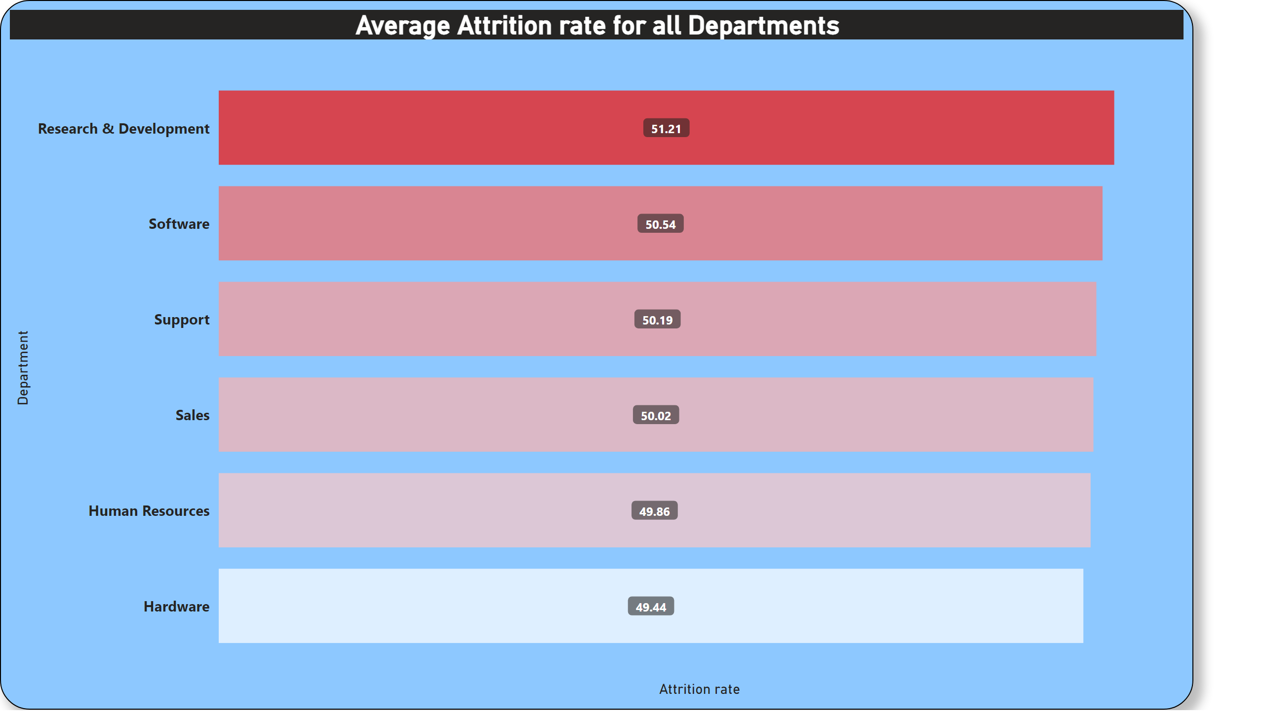
KPI-1 Average Attrition rate for all Departments
The Attrition rate for all given departments is approximately same near about 50% .
Attrition rate is highest in Research and Development department i.e.(51.21%)
And lowest in Hardware department i.e.(49.44%).

Slide 3
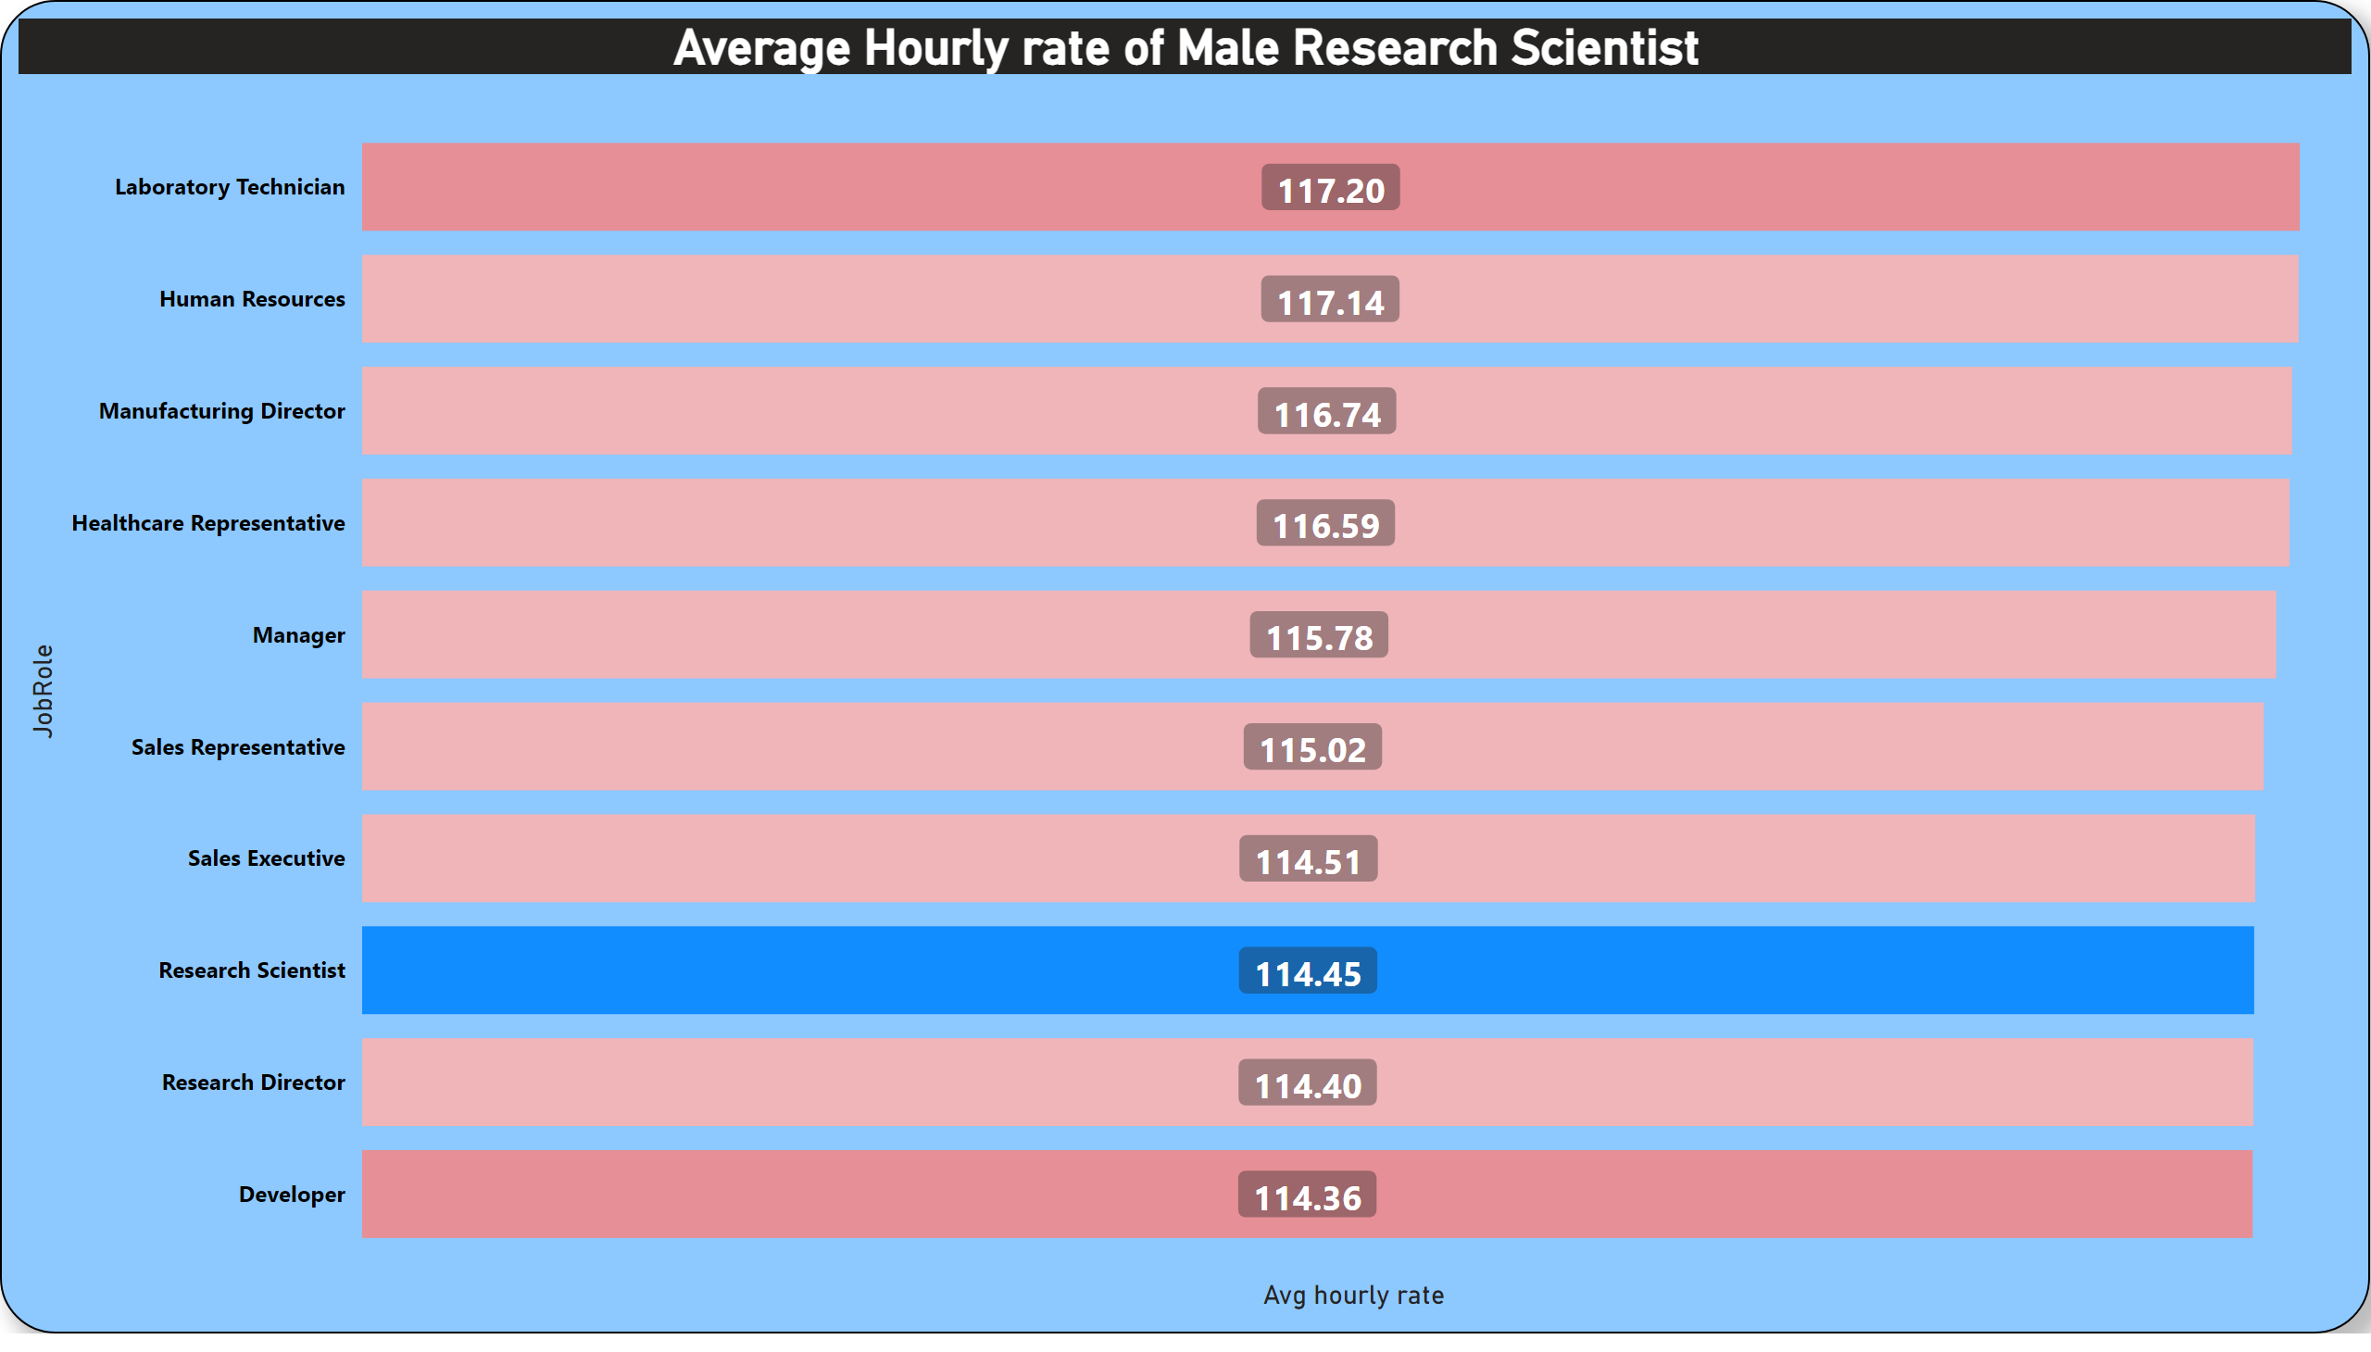
KPI-2 Average Hourly rate of Male Research Scientist
Average hourly rate of all the job roles in given dataset are in between 114 to 117 ₹ .
Average hourly rate for male research Scientist is 114.45 ₹.

Slide 4
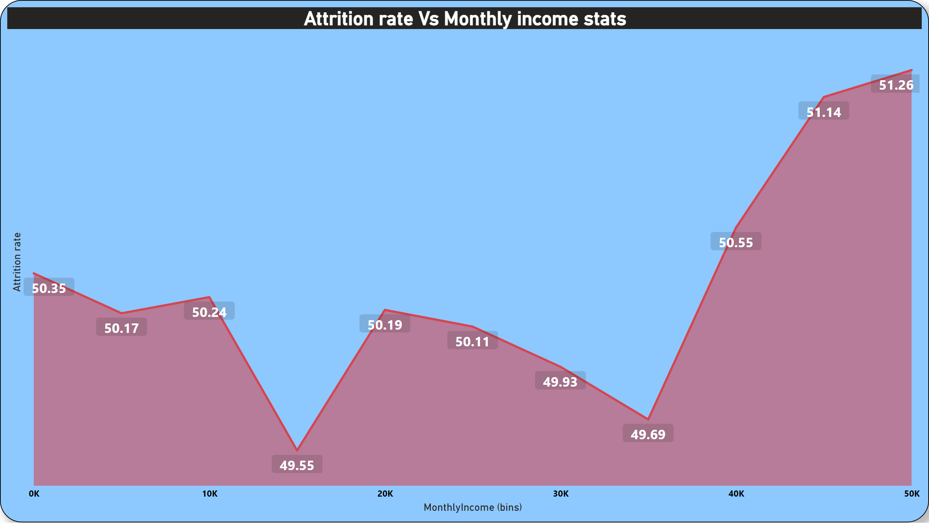
KPI -3 Attrition rate Vs Monthly income stats
The attrition rate is highest i.e.(51.26%) in the range of 45K to 50K.
The attrition rate is lowest i.e. (49.55%) in the range of 15k to 20K.

Slide 5
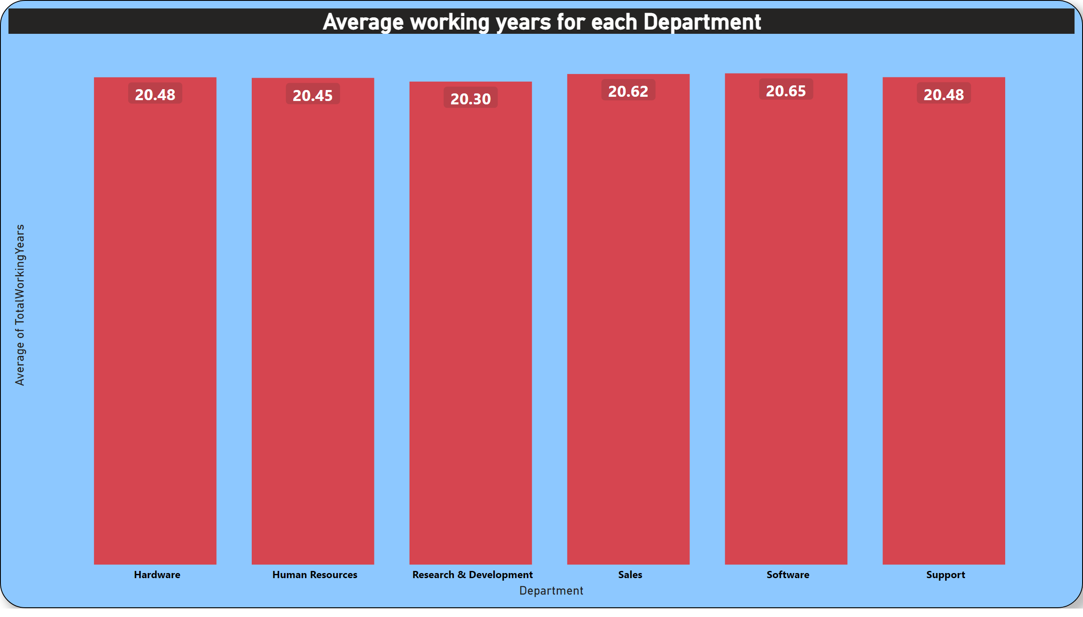
KPI-4 Average working years for each Department
Average working years for all the departments is approximately same near about 20.50 years.
Average working years is higher in software department(20.65) and lower in Research and development(20.30).

Slide 6
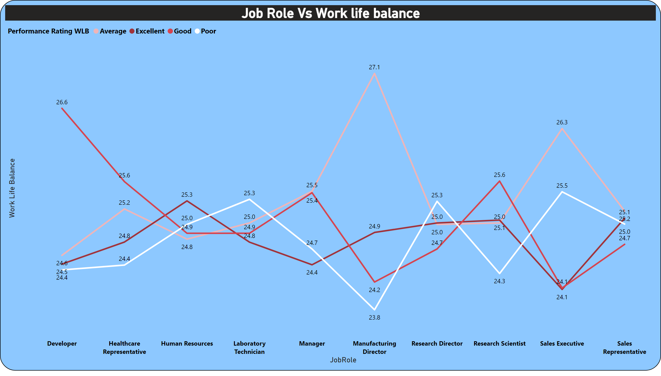
KPI-5 Job Role Vs Work life balance
Work life balance for Human resources is Excellent in all of the given Job roles.
Work life balance for Manufacturing director is poor in all of the given Job roles.

Slide 7
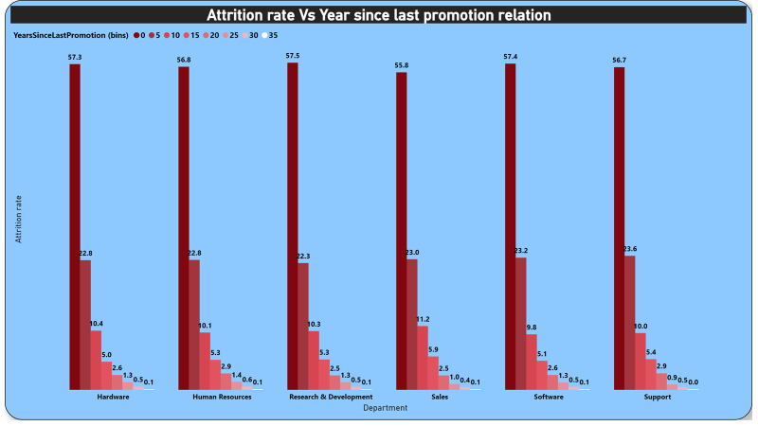
KPI-6 Attrition rate Vs Year since last promotion relation
Maximum attrition is observed in the 0-4 years since last promotion occurred.
Almost all departments have similar rate of attrition.
Less no. of people have left the organization who have got promotion 35-40 years back .

